Slide 1

General Password Problem Troubleshooting
Ellen Guo
2024.05

Slide 2
Objectives
After learning this course, you will be:
  Familiar with and understand the initialization methods of recorder, camera, intelligent building equipment. etc.
  Familiar with and understand the common initialization process, including local initialization, WEB initialization, tool initialization;
  Familiar with and understand the process of common password resetting for recorder, camera, VTO and access controller;
  Known about troubleshooting steps for common password problems.

Slide 3
1
2
3
4
5
Initialization function introduction
Password reset for front-end devices
Password reset for storage devices
Password reset for intelligent building devices
Password reset for other devices

Slide 4
Initialization function introduction
Let’s consider that the admin user of the original device uses the factory-set password.
As a result, the account and password are prolonged exposure of these credentials, which may contribute to security risks.
The equipment initialization feature was introduced in order to avoid risks, and in response to the national security law and network security law. During device initialization, users must establish a new admin username and password upon their device login session to ensure security.
Common initialization functions are WEB initialization, local initialization, tool initialization. We will introduce specific initialization steps one by one.

Slide 5
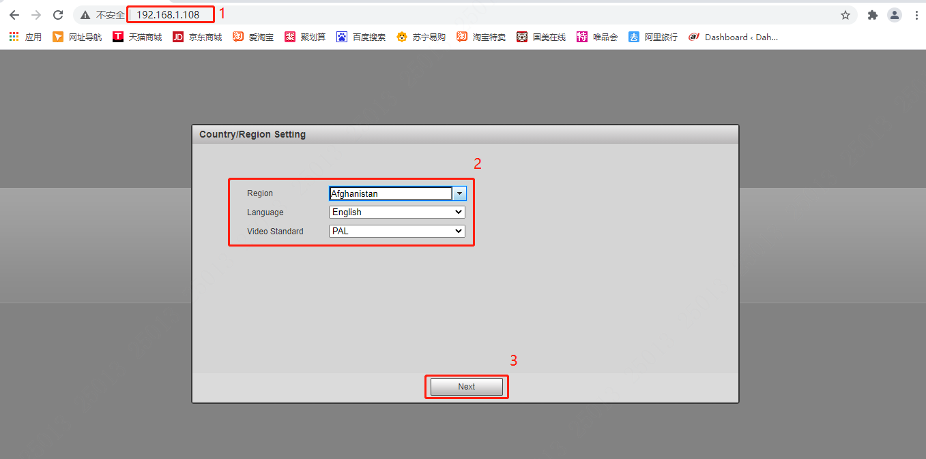
Initialize on Webpage
1）Initialize the machine:
Step1: Open the browser and enter the IP address of the device in the address bar. Factory default IP：192.168.1.108; select the corresponding region and language according to the actual situation, click Next to go to the next step.

Slide 6
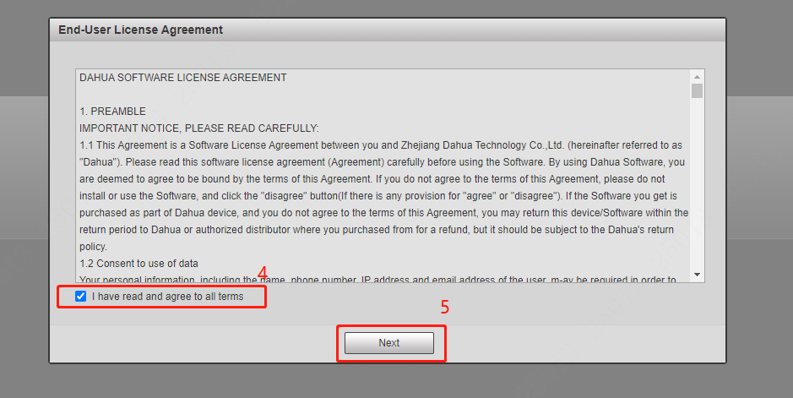
Initialize on Webpage
Step2：End-User License Agreement - Read through the End-User License Agreement, when ready check the agreement box to enable "Next".

Slide 7
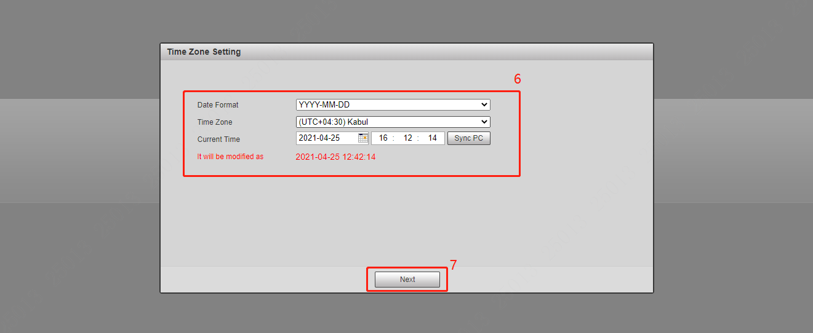
Initialize on Webpage
Step3：Set the system time zone and system time according to the actual situation.

Slide 8
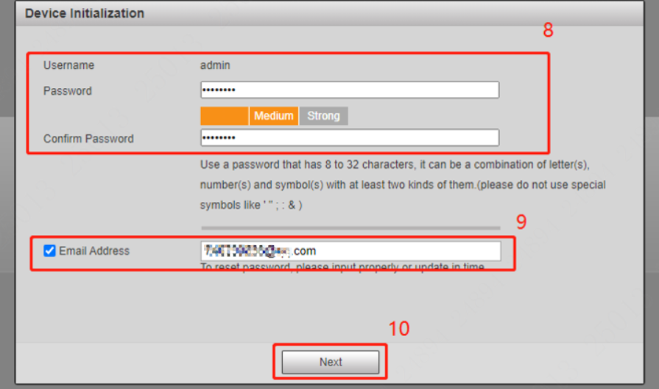
Initialize on Webpage
Step4: Enter the new password and confirm it again. For the reserved Email, you do not need to select “√” (It is recommended to enter the correct Email address so that the password can be retrieved), and continue.

Slide 9
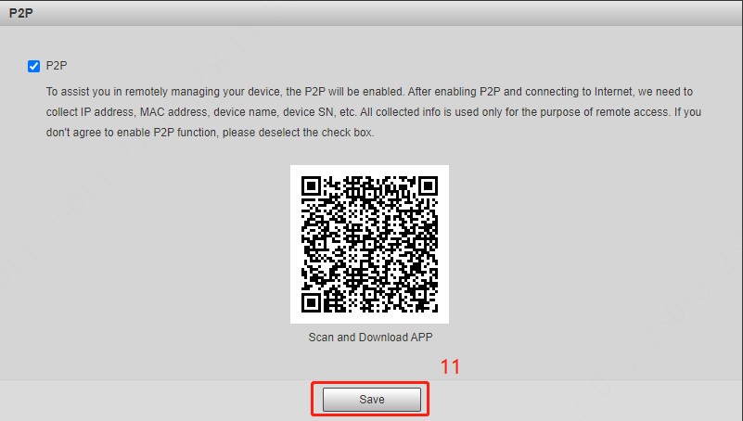
Initialize on Webpage
Step5：Select P2P (if you need to connect to the Extranet), click Save, initialization is completed

Slide 10
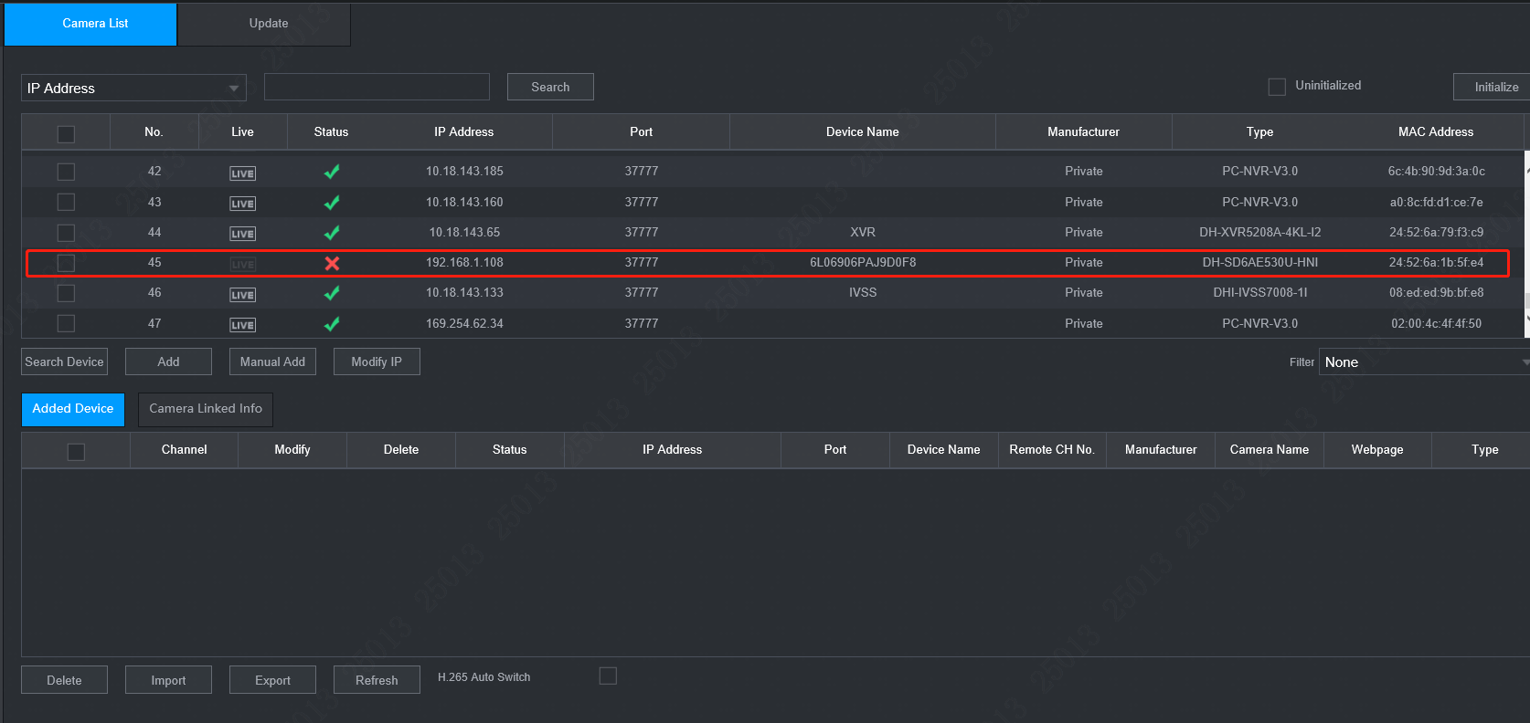
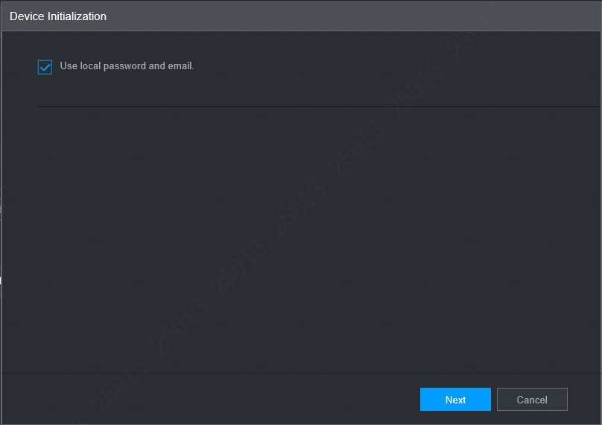
Initialize on Webpage
2） Initialize the remote device
NVR can initialize remote devices within the same LAN.
Step1： Log in to the WEB configuration page of the NVR.
Step2：Select Settings > Camera > Remote Device. The Remote Device page will be displayed here.
Step3：Click “Search Device” and select “Uninitialized”. The uninitialized remote device will be displayed here.
Step4：Select an uninitialized remote device and click Initialize. The Password Reset page will be displayed.

Slide 11
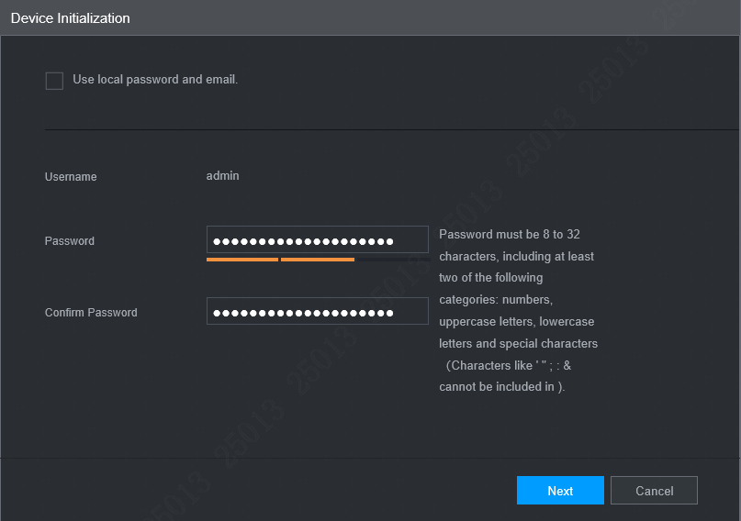
Initialize on Webpage
Step5：Set the password for the remote device
If “Use local password and email” is selected, the remote will device automatically use the password and email address of the admin user from the current device.
If “Use local password and email” is not selected, then you need to set the password and email address as prompted.

Slide 12
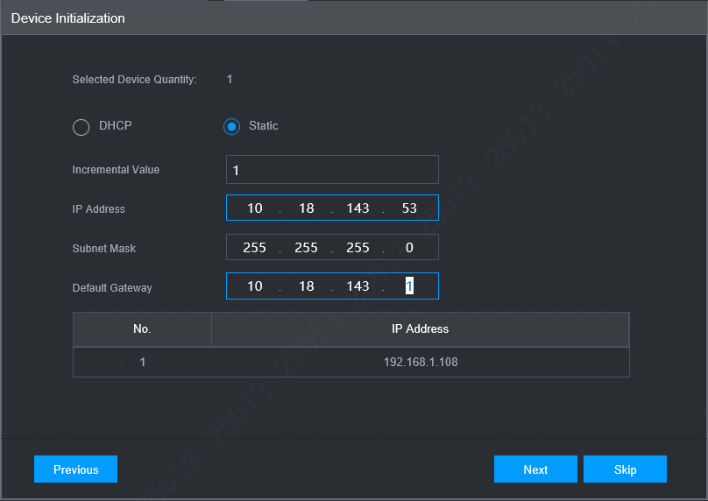
Initialize on Webpage
Step6：Click “Next”. The Change IP page will be given. Set the remote IP address based on plan, as shown in the figure below.

Slide 13
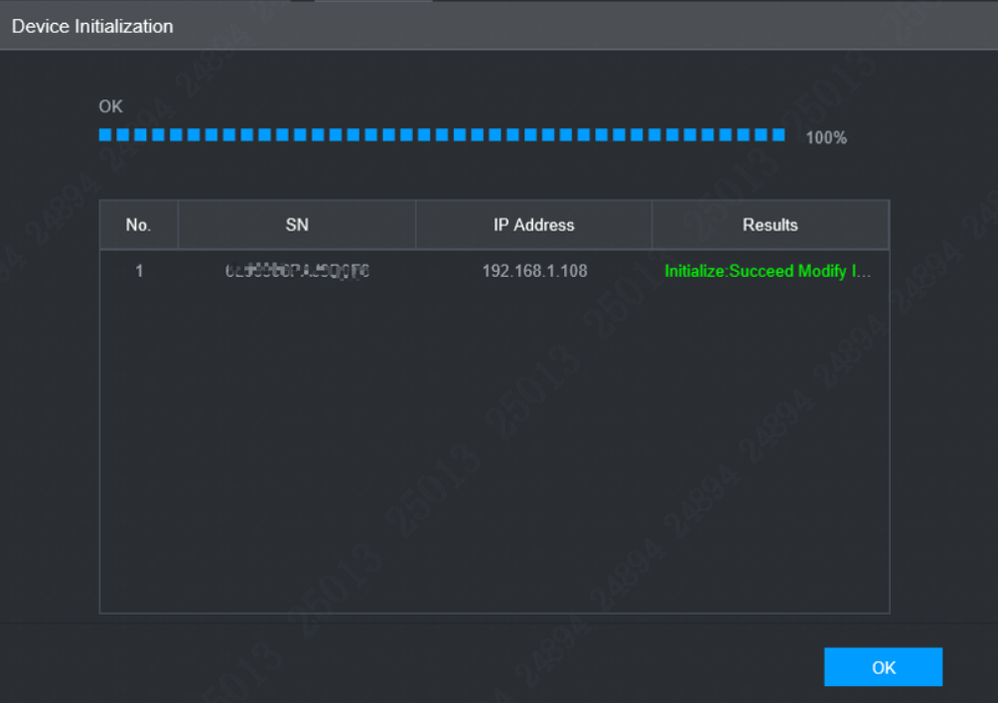
Initialize on Webpage
Step7：Click "Next" to display the initialization progress bar. Click OK to complete the initialization.

Slide 14
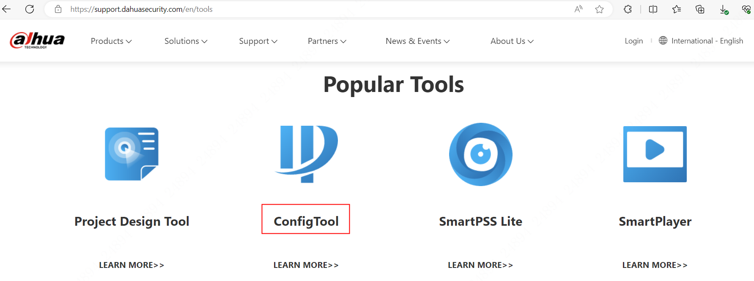
Initialize on ConfigTool
The quick configuration tool (Configtool) is a software that can quickly search the IP address of Dahua equipment in the local area network and configure through the computer. You can initialize remote devices in the same LAN separately or in batches. Operations cannot be performed on uninitialized devices and they are displayed in gray in the device list. Moreover, they are excluded from displaying related information in other interfaces.
Step1: Install quick configuration tool. It can be installed and used by clicking in Dahua official website（https://www.dahuasecurity.com）—support—Download Center—Tools—ConfigTool.

Slide 15
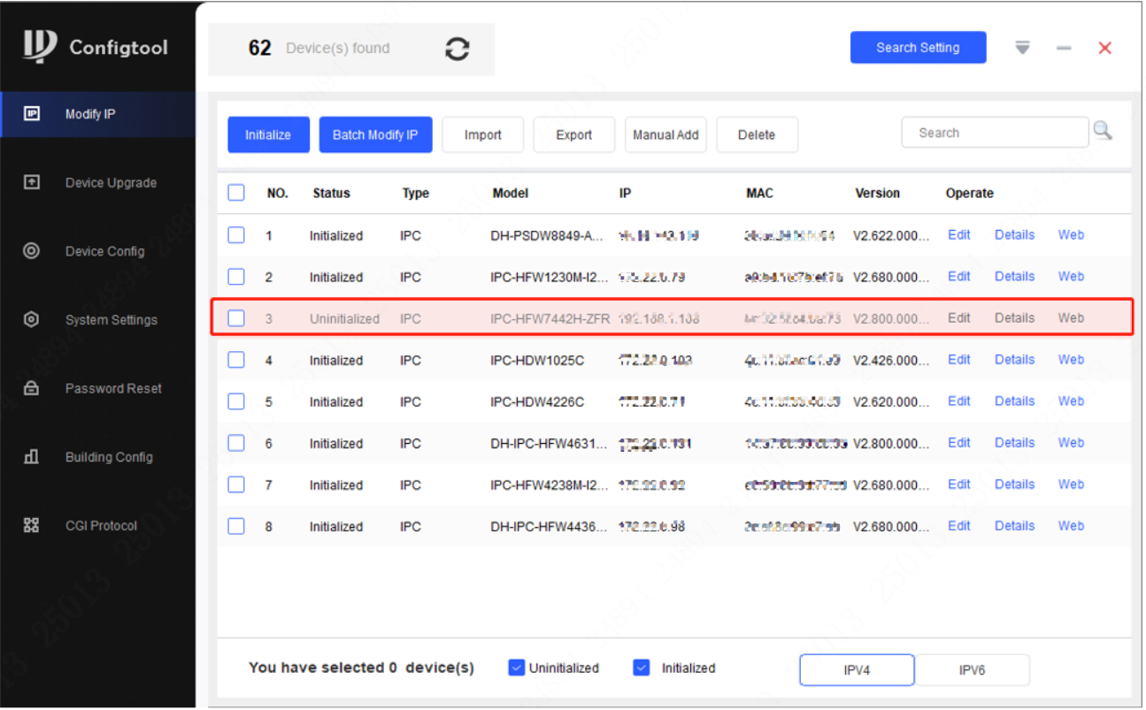
Initialize on ConfigTool
Step2: Open configtool, search IP address of the device, when the front-end device is not initialized, the searched device information is in gray. At that time, the IP address of the device cannot be modified or configured, so initialization is required.

Slide 16
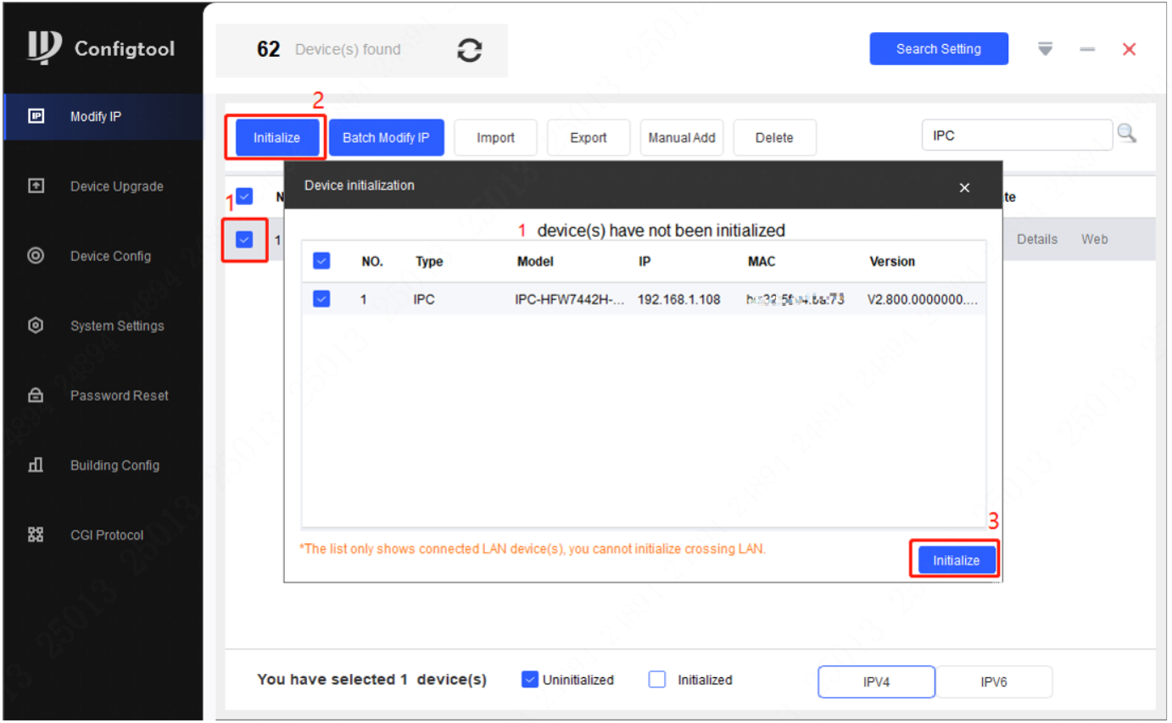
Initialize on ConfigTool
Step3: Select the searched uninitialized front-end devices, click the initialization menu in the upper left corner, and continue to select initialization in the pop-up window.

Slide 17
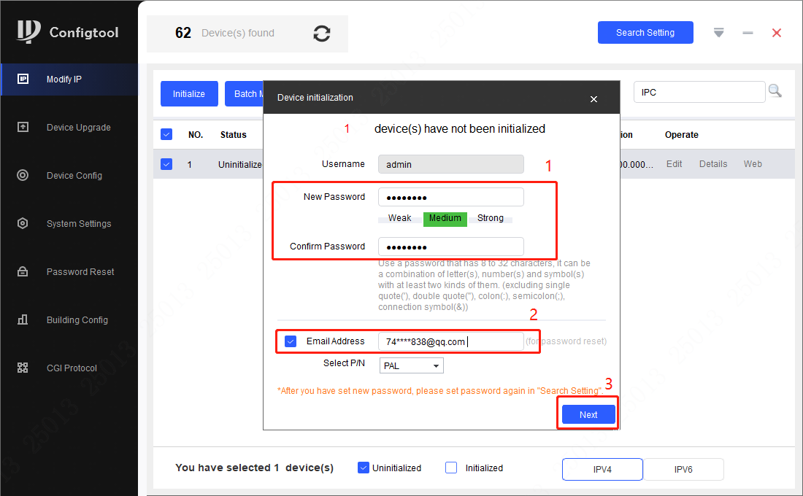
Initialize on ConfigTool
Step4: Enter the new password and confirm it again (for “Email Address”, if you have enabled this function by selecting “√”, once you have forgotten the password, it can be retrieved by the reserved “Email Address”) . And click Next.Complete the initialization process

Slide 18
1
2
3
4
5
Initialization function introduction
Password reset for front-end devices
Password reset for storage devices
Password reset for intelligent building devices
Password reset for other devices

Slide 19
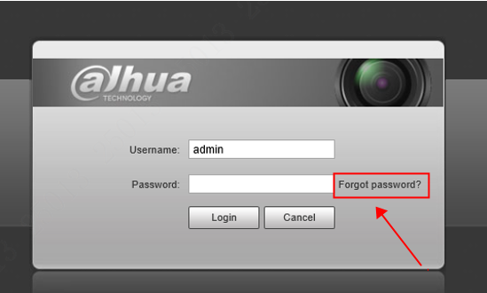
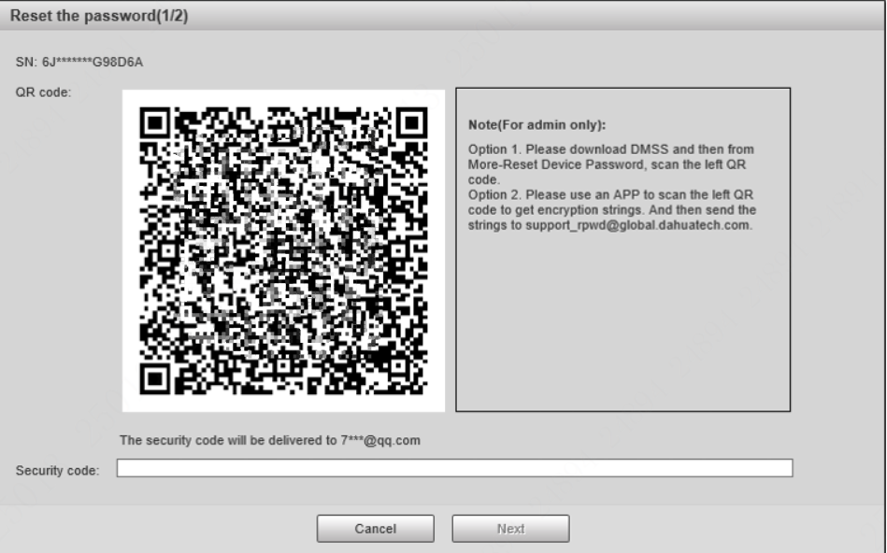
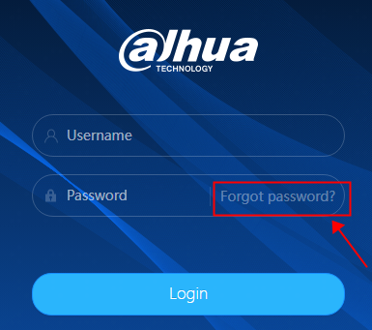
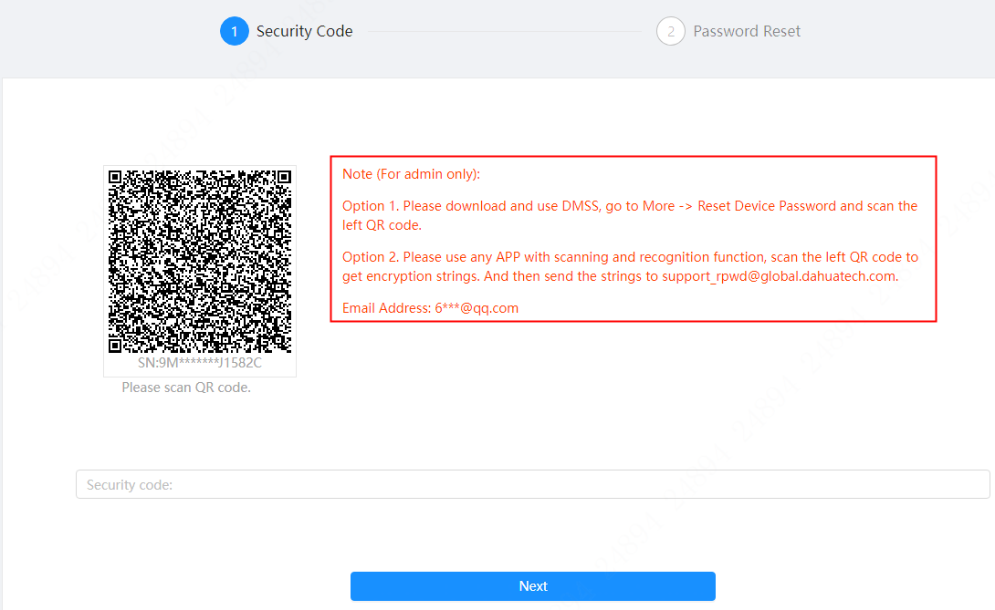
Reset on Webpage
Step1：Open web browser, enter the IP address of the device you want to log in in the address bar, and click "Forgot Password" on the right side of the login page. The "Password Reset“ prompt will pop up, as shown below:
Web3.0
Web5.0

Slide 20


Reset on Webpage
Step2：The password reset interface presents two methods for retrieval. The first method involves scanning a QR code and resetting the password through DMSS.
QR code of Android client ： QR code of iOS client ：

Slide 21
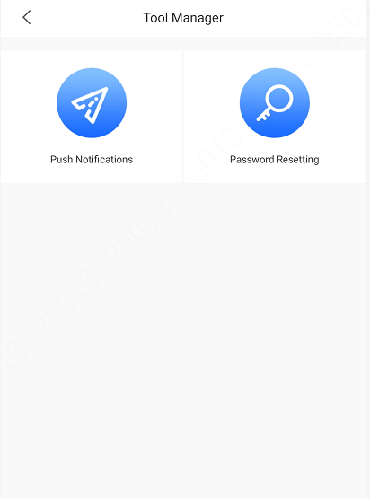
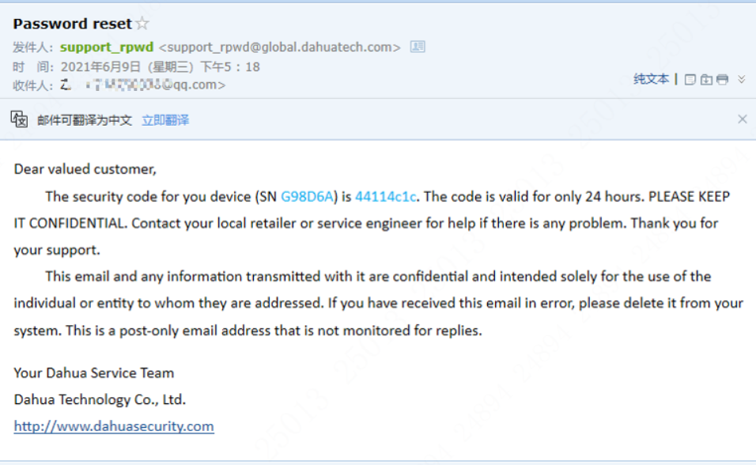
Reset on Webpage
Step3：Run the application ,and go to ME-Tool Manager-Password Resetting. Scan the QR code, and you will receive corresponding security codes in reserved mailboxes, as shown below:

Slide 22
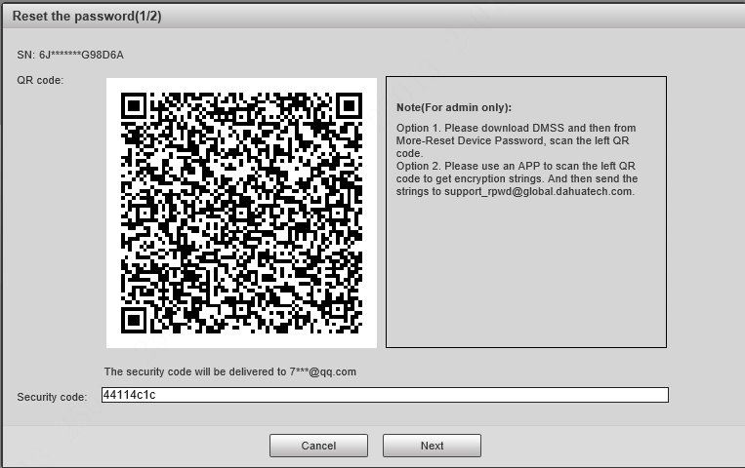
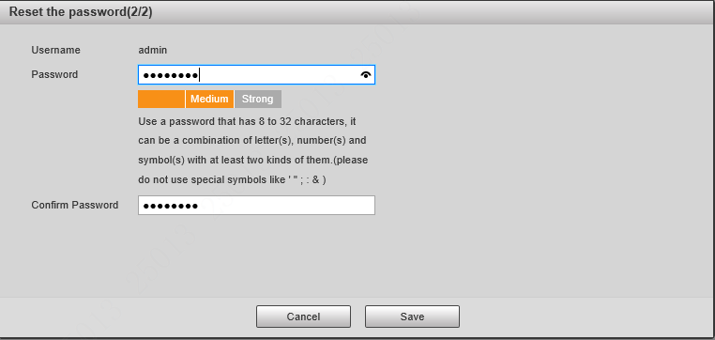
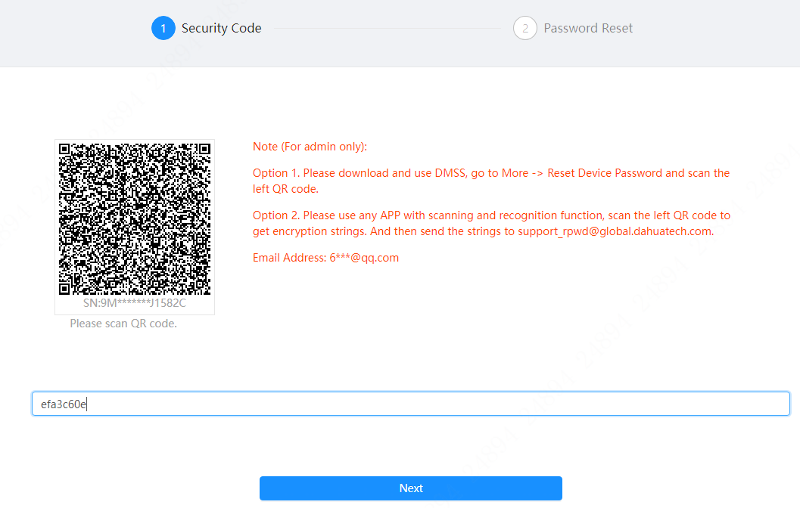
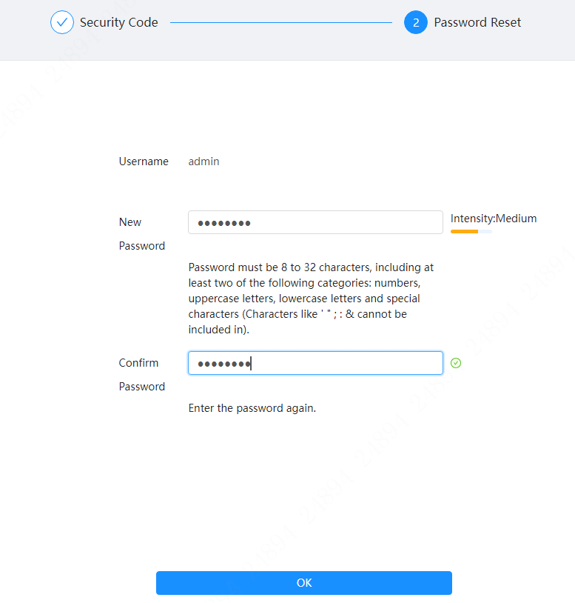
Reset on Webpage
Step4：Enter the security code you received in the email and click "Next" to reset the password.
Web3.0
Web5.0

Slide 23
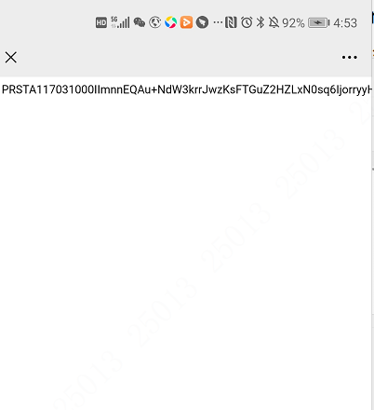
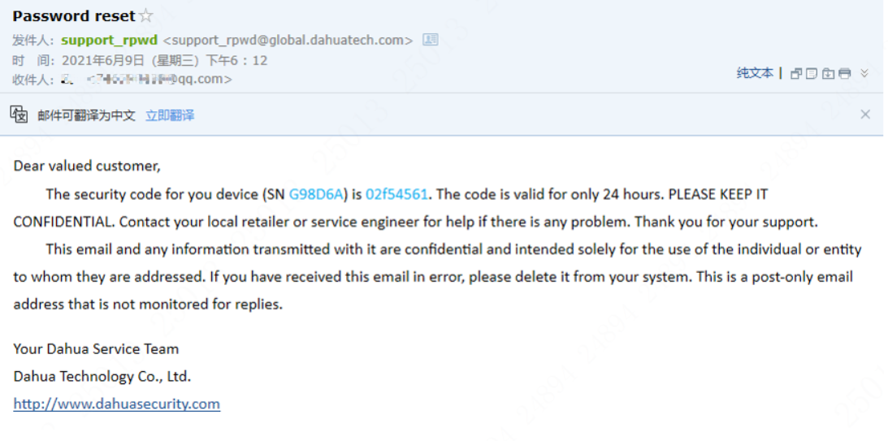
Reset on Webpage
Step5： You can also scan the code through other apps to finish resetting.
You can use an app to scan the QR code to get encryption strings, copy the encrypted string and send it to support_rpwd@global.dahuatech.com. You will receive the security code in the reserved mailbox, as shown below:

Slide 24
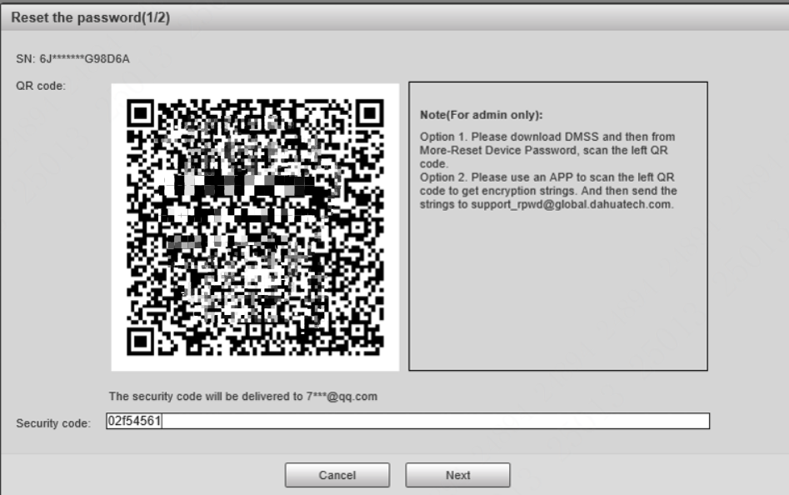
Reset on Webpage
Step6： Enter the security code received in the email and click "Next" to reset the password.
Web3.0
Web5.0

Slide 25
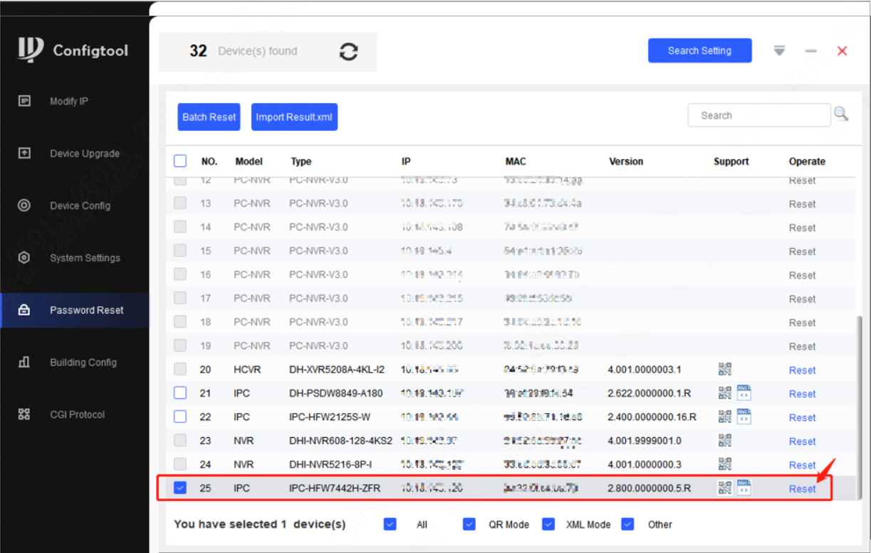
Reset on ConfigTool
1）Reset the password by scanning the code
Step1：Download Configtool and enter the password reset interface, as shown below:

Slide 26
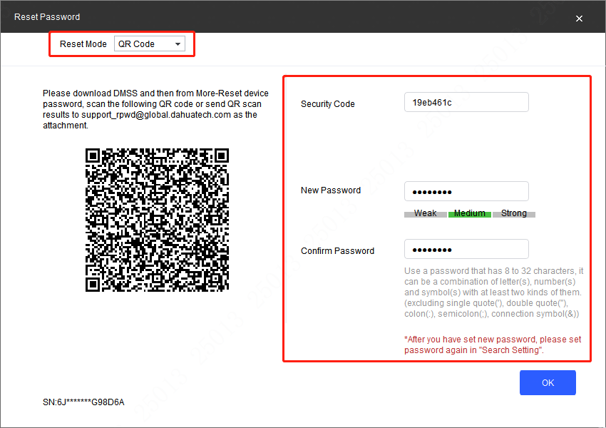
Reset on ConfigTool
Step2：Select the device you wish to reset and click "Reset" to display the password reset interface. Select "QR Code" mode, scan the QR code on the left to retrieve the password through DMSS or some other apps (same as web reset), click OK to finish reset, as shown in the screenshot below:

Slide 27
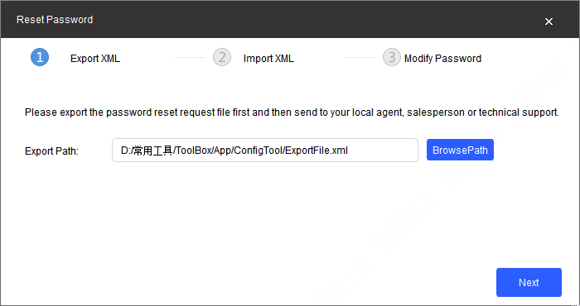
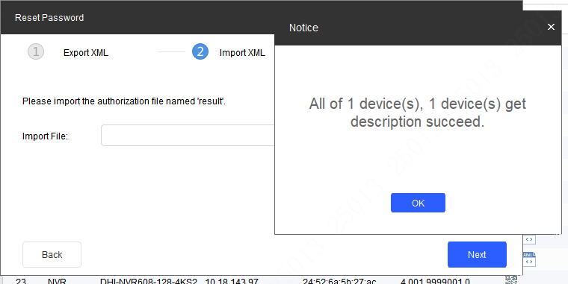
Reset on ConfigTool
2） Retrieve through XML file
Step1：Select the device you wish to reset and click “Reset”. The password reset prompt will pop up. Select XML File and select the corresponding path to export the XML file.

Slide 28
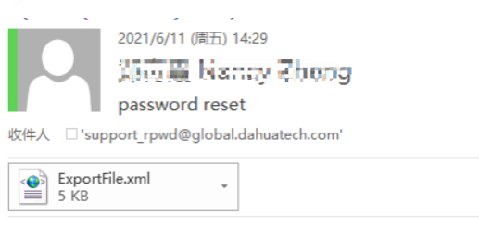
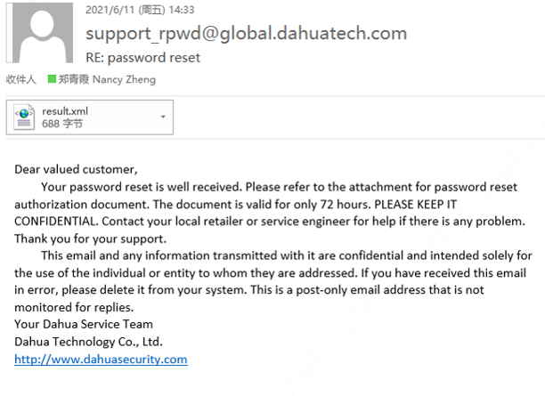
Reset on ConfigTool
Step2：Send the exported file to support_rpwd@global.dahuatech.com(Dahua)/support_gpwd@htmicrochip.com(neutral), the mailbox will return the result. XML file, as shown below:
Note：1. If you want to export XML files for multiple devices, you need to export the XML files seperately. The XML files cannot be compressed but need to be sent as original files.
2. The validity period of the security code is 72 hours.
3. Only authorized mail can send exported file and region can help apply for the permission.

Slide 29
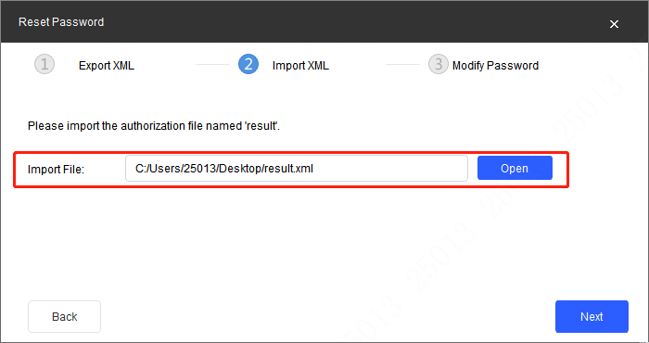
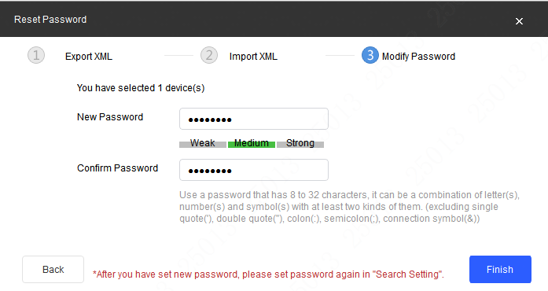
Reset on ConfigTool
Step3： After importing the result. XML file, you can reset the password and click Finish to complete the process, as shown in the figure below :

Slide 30
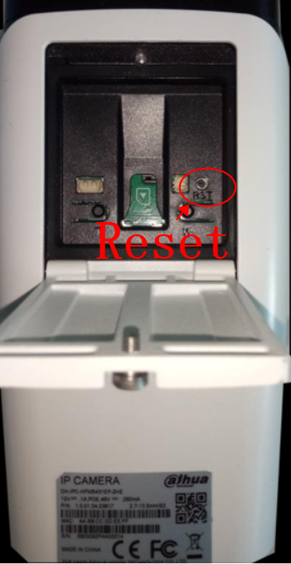
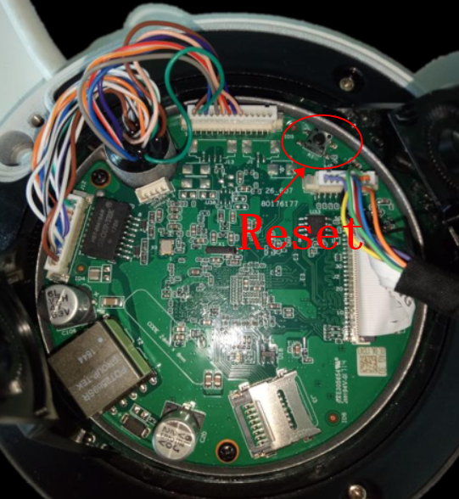
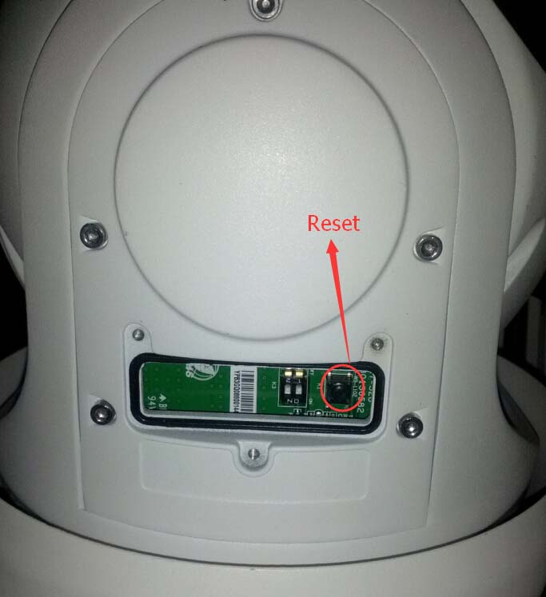
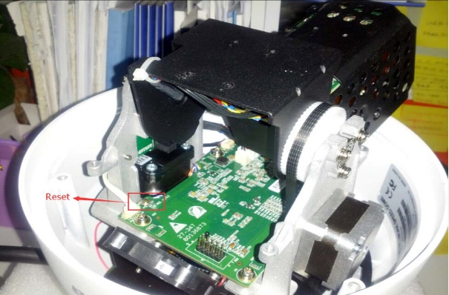
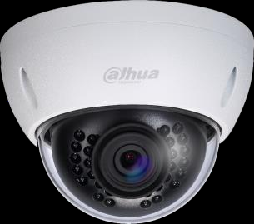

Hardware recovery
IPC /PTZ Hardware Reset:Press the reset button for 5 seconds.
IPC-HFW5xxx-ZE(Z5E)
IPC-HDBW5XXXR-ZE
SD6C series Speed Dome
SD50(52C)series Speed Dome
The positions of reset keys for different models of IPC/PTZ can be found in the following document

Slide 31
1
2
3
4
5
Initialization function introduction
Password reset for front-end devices
Password reset for storage devices
Password reset for intelligent building devices
Password reset for other devices

Slide 32
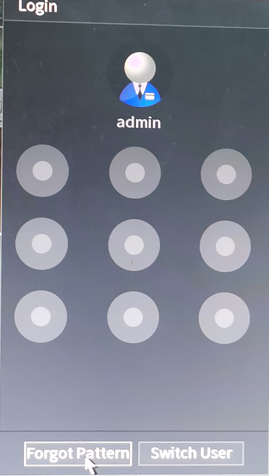
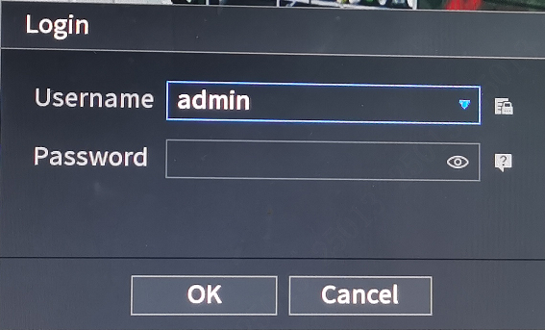
Local reset
Step1： Power on the device and proceed to the login interface. If there is a gesture password, the system interface is displayed as shown below：
If no gesture password is set or if you click “Forgot gesture”, the following interface will be shown:

Slide 33
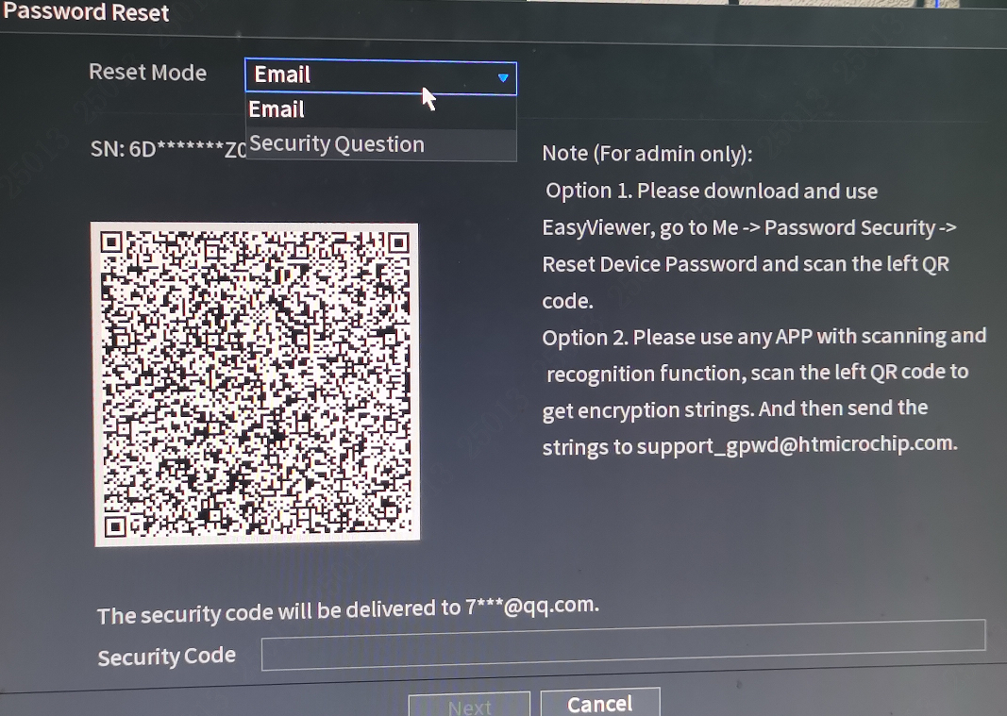
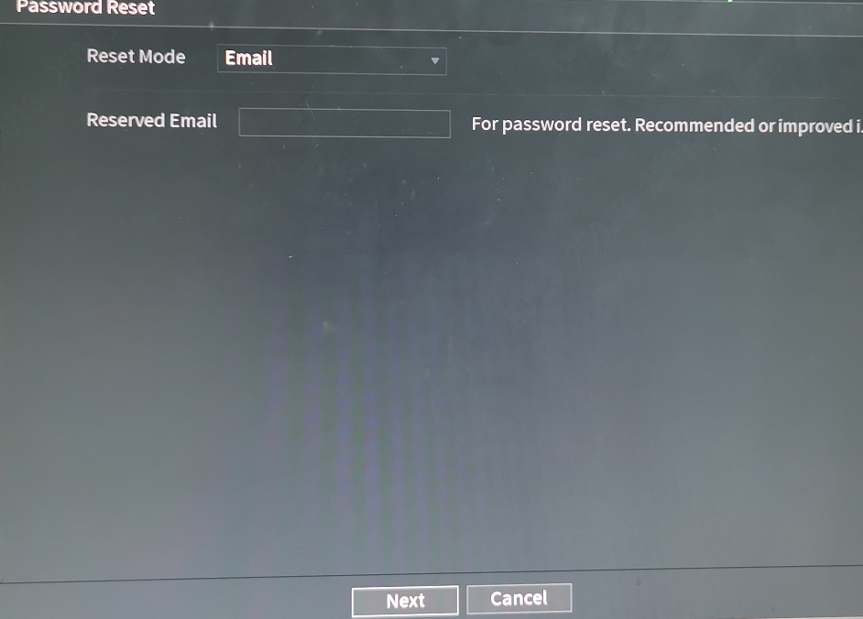
Local reset
Step2： Click forgot password on the right. If reserved email has been set, the system interface is shown as following
If no mailbox is reserved, the following page is displayed. (Please note that only the local webpage offers the functionality to re-enter a previously reserved email address for recovery purposes. ）：

Slide 34
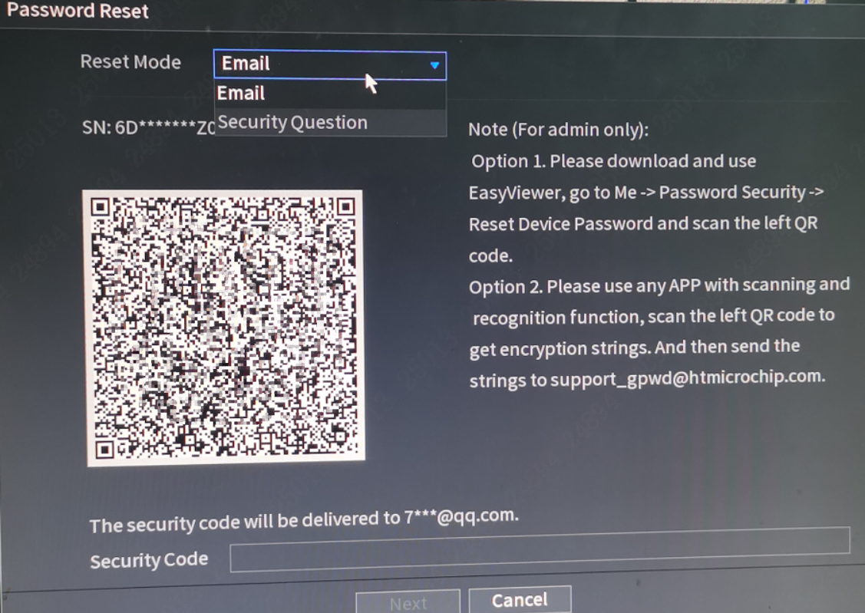
Local reset
Step3：Password reset
（1）Email retrieval, reset is the same as the above WEB interface password reset, so we skip the steps.

Slide 35
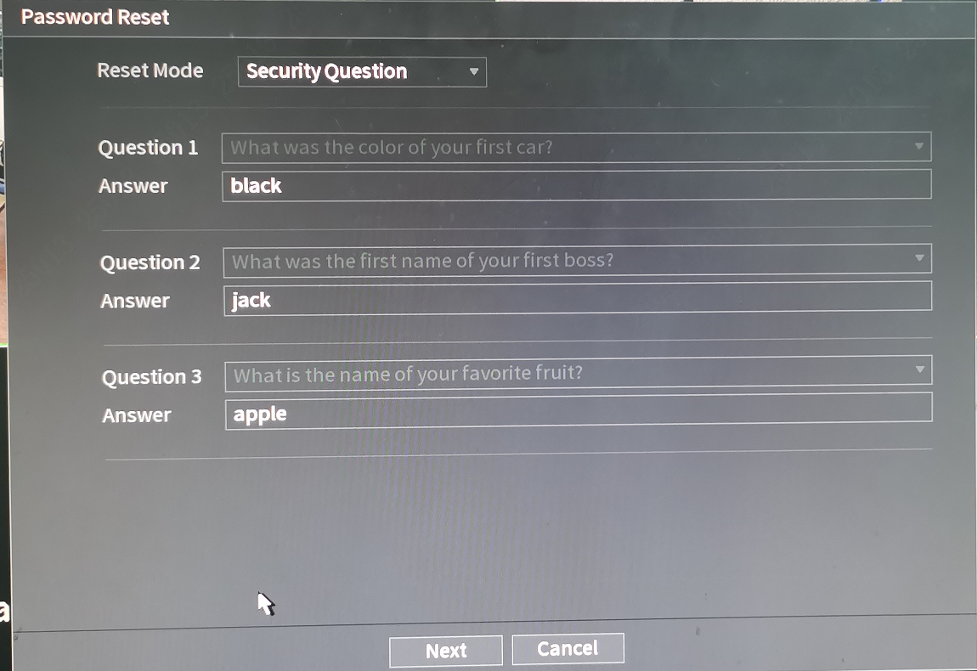
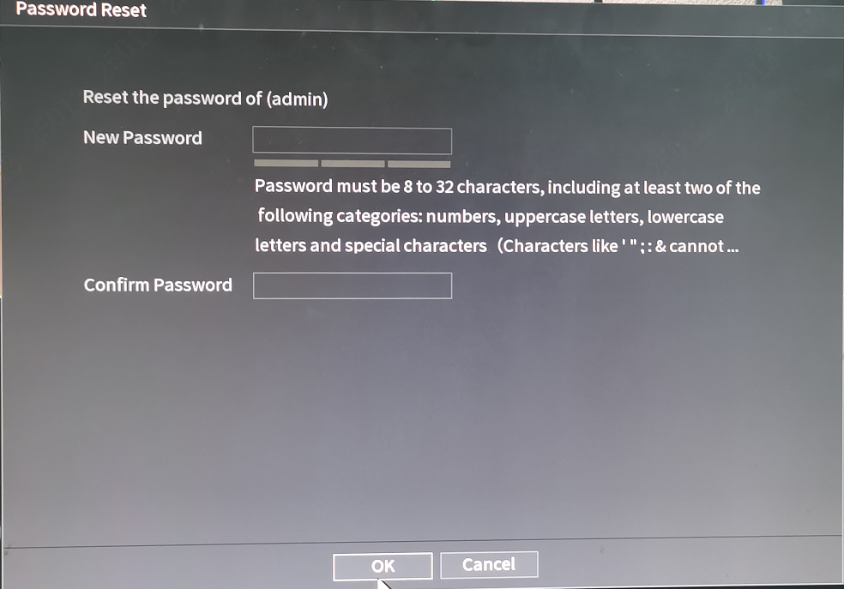
Local reset
Step3：Password Request via Security Question
（2） When the password protection question interface is displayed, enter the answer of the password protection questions set before. Click "Next”, enter the new password and confirm the password, and click OK to complete the password reset.

Slide 36
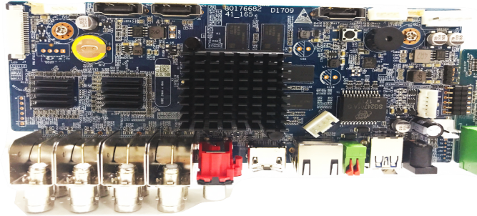
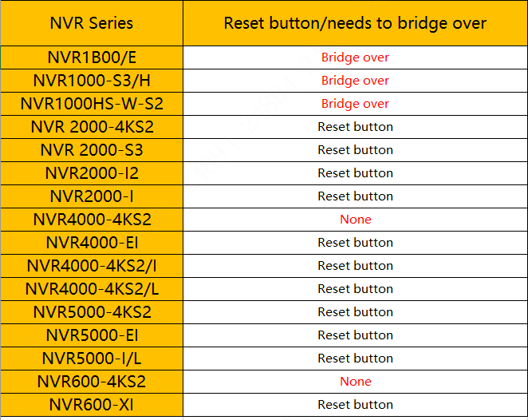
Hardware Recovery
Operation steps and precautions:
Step1：Press the reset button
Step2：Power on the device while the reset button is pressed
Step3：Continue to press the reset button for more than 5s until the device restarts
Tips：
1. After the device restarts, the device will achieve factory default automatically, which is consistent with the factory default options in the software.
2. The program will be restored to the current version of the firmware, and will not be restored to the version when the product leaves the factory .
3. The factory default function just clears configuration, and the system version will not be changed. For example, if the customer upgraded the language pack of the program, then long pressed the reset button, the language of the device will not be changed after it reboots.
Reset button

Slide 37
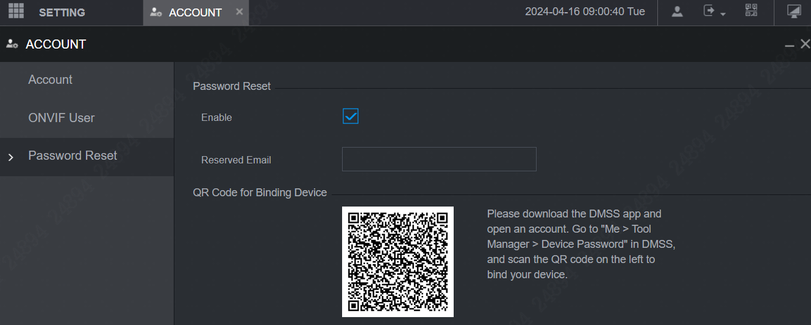

Device binding DMSS account reset
Step1：Log in to the web of the NVR device, go to ‘Setting>Account>Password Reset ‘interface, and select Enable,
Download the DMSS app and log in with an account. Go to "Me > Tool Manager > Device Password" in DMSS, and scan the QR code on the left side to bind your device.
DMSS
NVR

Slide 38


Device binding DMSS account reset
Step2：On the NVR login page, click on Forgot Password，Enter reset mode

Slide 39


Device binding DMSS account reset
Step3: Log in to DMSS with an account, go to "Me>Tool Manager>Device Password" in DMSS, click on the bound device serial number, click OK, scan the QR code of NVR, and obtain the security code

Slide 40


Device binding DMSS account reset
Step4: Enter security code and reset password

Slide 41


The decoder password reset
1）To reset the password on devices with over 12 channels (such as the NVD1205, NVD1505, NVD1805, and NVD2105), use the restore default button. Press and hold the reset pinhole on the main board card for 10-15s to return the device to its factory settings, as shown on the right side:
2）For restoration via the power button (such as NVD0105,NVD0405,NVD0605,NVD0905).When the device is powered on, press the power button for three times consecutively within 1 second to restore the default value. The device does not need to be restarted. Wait for 3-5 minutes and use the default IP address to log in.

Slide 42


The matrix password reset
Use hardware clear configuration to recovery password, the M70-E main control board has a reset hole on the left, as shown in the number 1 in the figure below, M60 is at the top of the front of the main control board, poke the device with a sharp object for 3-5s, the device will restart, and the device will restart After the password will be restored to the default admin.
M70-E
M60

Slide 43


Keyboard password reset
Default keyboard password ：
NKB1000 Default user name: admin; Password: 888888. (NKB1000-E has no default password)
NKB5000 Default user name: admin; Password: admin.
Keyboard password forgotten ：
NKB1000 and NKB1000 –E: You can long press ESC until the device restarts to clear the configuration. After the NKB1000-E is restored to the factory reset, it is necessary to initialize the account and password first.
NKB5000/5200 :long press the three-line“ ” icon for more than 15 seconds, wait for a prompt to clear the configuration, and press Confirm to restart the device to finish clearing.
NKB1000
NKB5000/5200

Slide 44

The EVS password reset
1、 EVS device of old program reset:
Old EVS50 and EVS70 series devices don’t support password reset on web, If you forget password, please send to RMA or contact Dahua technicians.
Notes:
串口

Slide 45



The EVS password reset
2、EVS device of new program reset:
Step 1: Open the login page on web with EVS IP, Click Forgot Password?
Step 2: If you have set the reserved email before, the QR code will be displayed. you use DMSS to scan the QR Code , a security code will be sent to your reserved email automatically, then input it, click next and set new password.
If you have not set the reserved email before, it will let you to set one. After you set the email address, you will get the same QR code process, enabling you to reset your password.

Slide 46


The IVSS password reset
IVSS Preparation: Connect the keyboard and monitor to the IVSS
Step 1: After IVSS is powered on, keep pressing the keyboard * key until the menu appears, select Rescue Mode
Step 2: Enter the following menu, select [2] to clear data, then press Enter to restart the device. After the device restarts, Following the system reboot, proceed to reset the password..

Slide 47
1
2
3
4
5
Initialization function introduction
Password reset for front-end devices
Password reset for storage devices
Password reset for intelligent building devices
Password reset for other devices

Slide 48




Password reset for VDP devices
1. Password reset by reset button
1）If the device supports initialization, and can be reset through the WEB or tools. The reset process is the same as that of IPC. Please refer to the IPC reset part for details.
2）If the device does not support initialization or has not set up the reserved mailbox, you can try hardware reset or serial port to clear configuration.
a. In general, there is a reset button on the device rear panel. When the device is powering on, Press and hold the button for several seconds to reset to factory settings. You can check if this model has a reset button by looking at the manual.

Slide 49

VDP devices password reset
2. Password reset for device backend
If you forget the password, you can log in the device web, and go to -> local Setting to change it, as shown in the screenshot below->Type in numbers to reset password(numbers only)

Slide 50

The VDP password reset
3. VTH project password reset
If you have set up email on initialization，then you can follow the below steps to reset password

Slide 51



The VDP password reset
You can follow these steps to reset the password for VTH
Step 1 Select Setting > > Project Settings.
Step 2 On the Password Verification window, tap Forgot Password.
Step 3 Scan the QR code with any code-scanning app, bind your email box, send it by email to the specified email address on the screen to obtain a security code.
Step 4 Tap Next.
Step 5 Enter the password and confirm it, and then enter the obtained security code.
Step 6 Tap OK to complete resetting the password.

Slide 52


The VDP password reset
4. Network Password Setting
If you want to reset Network password, please follow these steps:
1) Select Setting > > Password on the home screen.
2) Tap Change Network Password.
3) Enable the cloud function.
4) Enter the password you planned and then confirm it, and tap .

Slide 53


Reset the password of the access controller
The default IP address of the controller is 192.168.108. The default port number is 37777.
Factory default of access controller method:
Single-door controller: dial DIP switch 1 and 3 to ON, power off and restart, the device will yowl. After that, dial DIP switch back to all off and it will return normal after short drop sound.
Two-door/four-door/eight-door controller: dial DIP switch 1, 3, 5, 7 to ON, power off and restart, the buzzer will ring. Dial all the DIP switches back after the device is on. And you will hear a short drop sound after that.

Slide 54

Reset the password for Time Attendance
ASA1222E&ASA1222G
If you forget the administrator password, please contact the technical staff at headquarters, Provide them with the current timestamp of the device, and the administrator password can be retrieved via backend tools.
Once you have the temporary password

Slide 55
1
2
3
4
5
Initialization function introduction
Password reset for front-end devices
Password reset for storage devices
Password reset for intelligent building devices
Password reset for other devices

Slide 56



The MPT password reset
Note: For MPT devices, if the password is forgotten, it can only be reset after restoring the device to its factory settings. Please be aware that restoring factory settings will erase all data on the device, including pictures, recordings, and so forth.
Step1: To reset the MPT220&221 devices, press the power button and the video button simultaneously while the device is powered off. For the MPT320, simultaneously press the power button and the volume down button, and then press the Select button to enter Recovery mode.
Volume down button
Power button
Power button
Video button
MPT220&221
MPT320

Slide 57



The MPT password reset
Step2: Select ‘Wipe data/factory reset’,seledt ‘yes’, select ‘Reboot system now’ to complete the factory reset.
Note: The MPT220 and MPT221 power button is "Confirm", the up and down of the video button is "Select"; MPT320 power button is "Confirm", the up and down of the volume button is "Select“.

Slide 58




The DMSS password reset
Step1: Enter the DMSS account login interface and click ‘ Forget password’.
Step2：Enter the new password and click ‘Get verification code’, and the verification code will be sent to your account email.
Step 3：The verification code will be sent to the account email. After entering the verification code in DMSS, reset the password.

Slide 59



The DSS password reset
Password reset of DSS all-in-one device
Step1: On the LCD Panel Interface, click ‘system click ‘.
Step 2：In the System Management Interface, click Password. In the pop-up dialog box, click the 'OK', and then set a new password..
If it is a pure software Device and the password needs to be recovered, please submit an ITR and contact technical support

